Slide 1
Product Keywords Extraction
My solution for the Shopee Technical assessment.

Slide 2
Outline
My Background
Task Overview
The Approach
Feature Engineering
Feature Importance
Insights
Conclusion and Future work
Notes:
Here is the outline of the today’s presentation.

Slide 3


My Background
Master of Electrical Engineering(NTU)
Lover of Data Scientist
Passion for E-commerce
Won two biggest Taiwan hackathon(2017)
(Fintech: 1/475)
(Data Science: 2/500+)

Slide 4
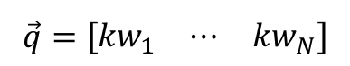
Task Overview
In this task, I have to suggest a list of best keywords for products.
So, it is little different from general keywords extraction.
I mean,
d₁
d₂
d₃
$$\vec{q}=\left[\begin{matrix}{kw}_{1} & ⋯ & {kw}_{N}\end{matrix}\right]$$

Slide 5
Task Overview
What is the definition of best keywords?
- The best keywords are the words that your customers use to look for product.
How do we automatically judge whether the words are the best keywords?
Notes:
So far so good, if you have any question, please feel free to ask, then we’are going to dive into how I solve this problem.

Slide 6
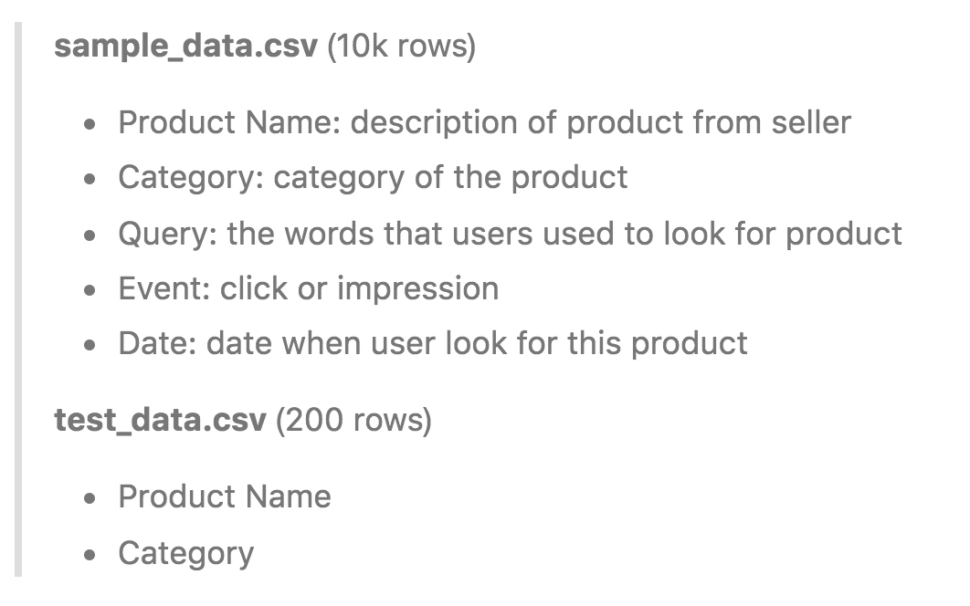
Task Overview-Data
There are two raw datasets: sample_data.csv and test_data.csv, which are both provided by Shopee.
Data Schema Explanation:

Slide 7
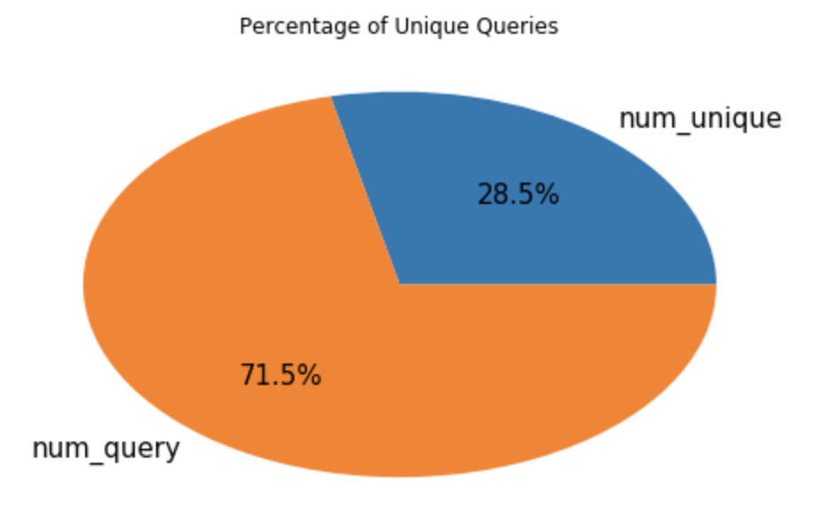
Task Overview-EDA
1. What's the percentage of unique queries ?

Slide 8


Task Overview-EDA
2. How many words users usually type in the search blank?

Slide 9
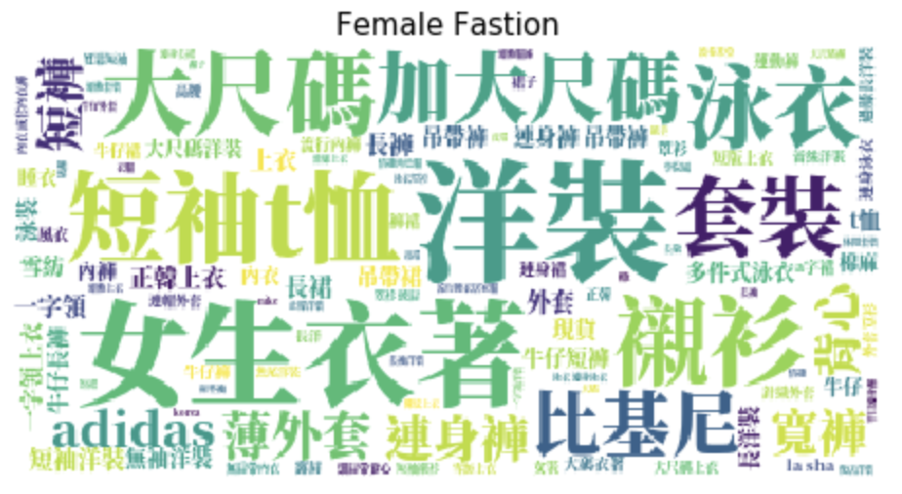
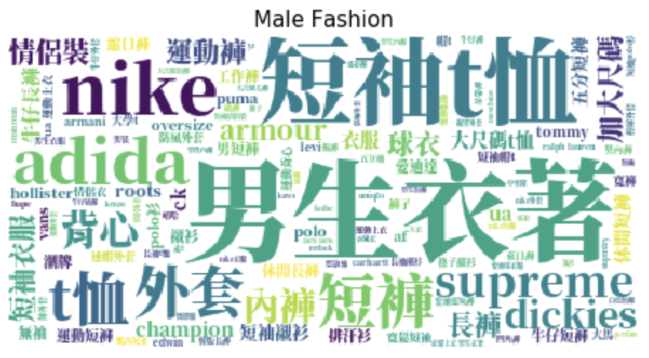
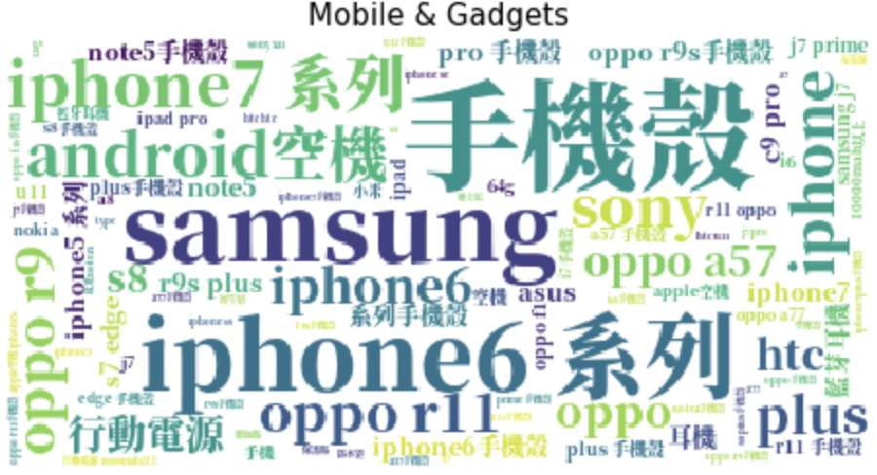
Task Overview-EDA
3.What is hot search in different category?

Slide 10
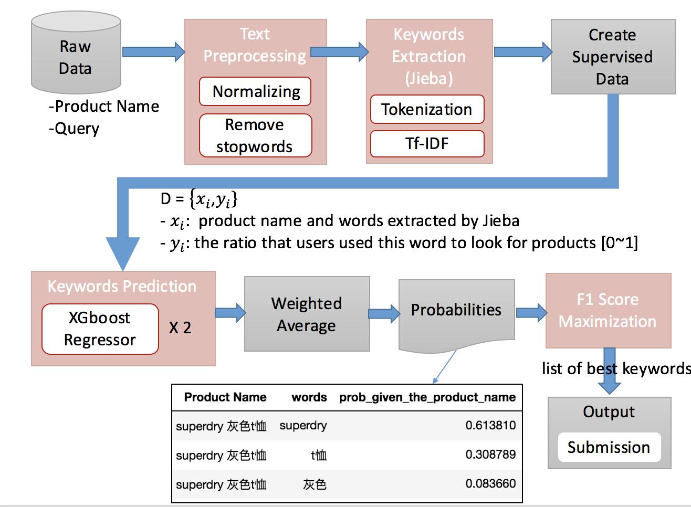
The Approach
A diagram of my keywords recommendation system flow
1
2
3
4

Slide 11
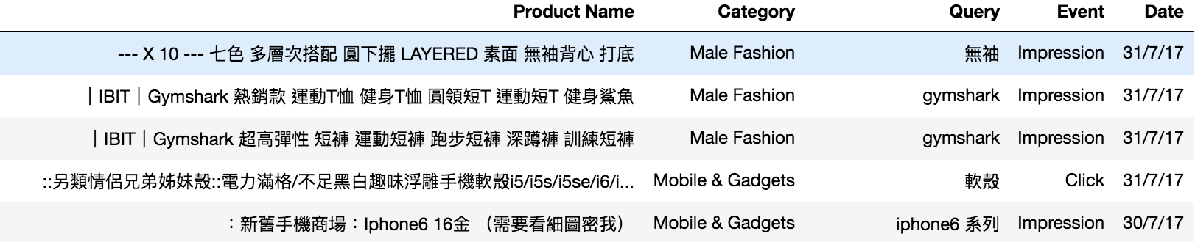
The Approach
What input of my system is?
We are given sample_data.csv

Slide 12
The Approach-Text Preprocessing
In order to reduce the words without too much information, there are basically two steps to filter raw data:
Normalizing:
“i phone” → “iphone”
“under armour” → “ua”
“a la sha” → “alasha”
Remove stopwords:
“美圖”, “系列”…
*Note: Different category need different category
Notes:
.

Slide 13
The Approach
A diagram of my keywords recommendation system flow
2
Notes:
Now, let’s move on step2 keywords extraction and I’m going to elaborate what Keywords Extraction did and why chose Jieba to do that?

Slide 14


The Approach-Keywords Extraction(Jieba)
There are lots of new words in our task, this makes tokenization harder.
Add own self-defined word
- self-defined word “小小兵”, for example
w/o self-defined token:
w self-defined token:
Thus, It can ensure a higher rate of correct tokenization

Slide 15
The Approach
A diagram of my keywords recommendation system flow
3
Notes:
Now, let’s move on step3 keywords prediction and
I’m going to explain why we consider machine learning and how I create supervised data before talking about model learning.

Slide 16
The Approach-Keywords Prediction
Why we need Machine Learning?
TF-IDF based
Those words may not be the best keywords.
We need a way to determine whether the words are best keywords.
The extracted words by Jieba

Slide 17
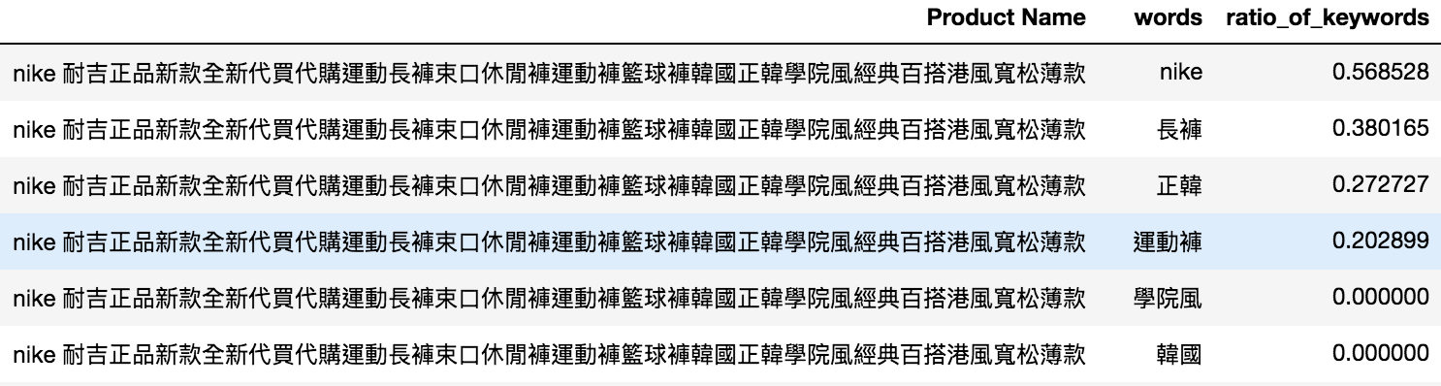
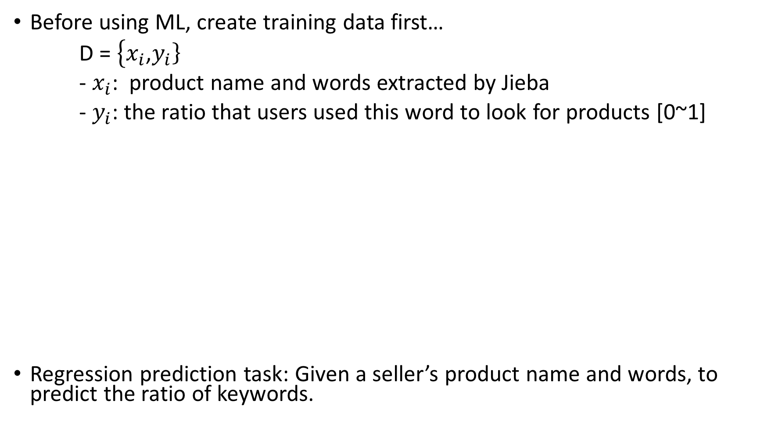

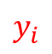
The Approach-Keywords Prediction
Before using ML, create training data first…
D = $\left\{x_{i}\right.$,$\left.y_{i}\right\}$
- $x_{i}$: product name and words extracted by Jieba
- $y_{i}$: the ratio that users used this word to look for products [0~1]
Regression prediction task: Given a seller’s product name and words, to predict the ratio of keywords.
$$x_{i}$$
$$y_{i}$$
Notes:
I decide to use machine learning to build a model to do so.
Before training model, we need a training data first.
What is input of my model?
Click1: This model depends on both the product name and words.
Cick2: And I use ratio that users used this extracted word to look for products is [0~1] as the target or label, which are generated from sample data.
Therefore, now the task was reformulated as a regression prediction task: Given a seller’s product name and the extracted words, to predict what ratio that users used this word to look for products is [0~1].
Now, we have supervised data for model to learn.

Slide 18
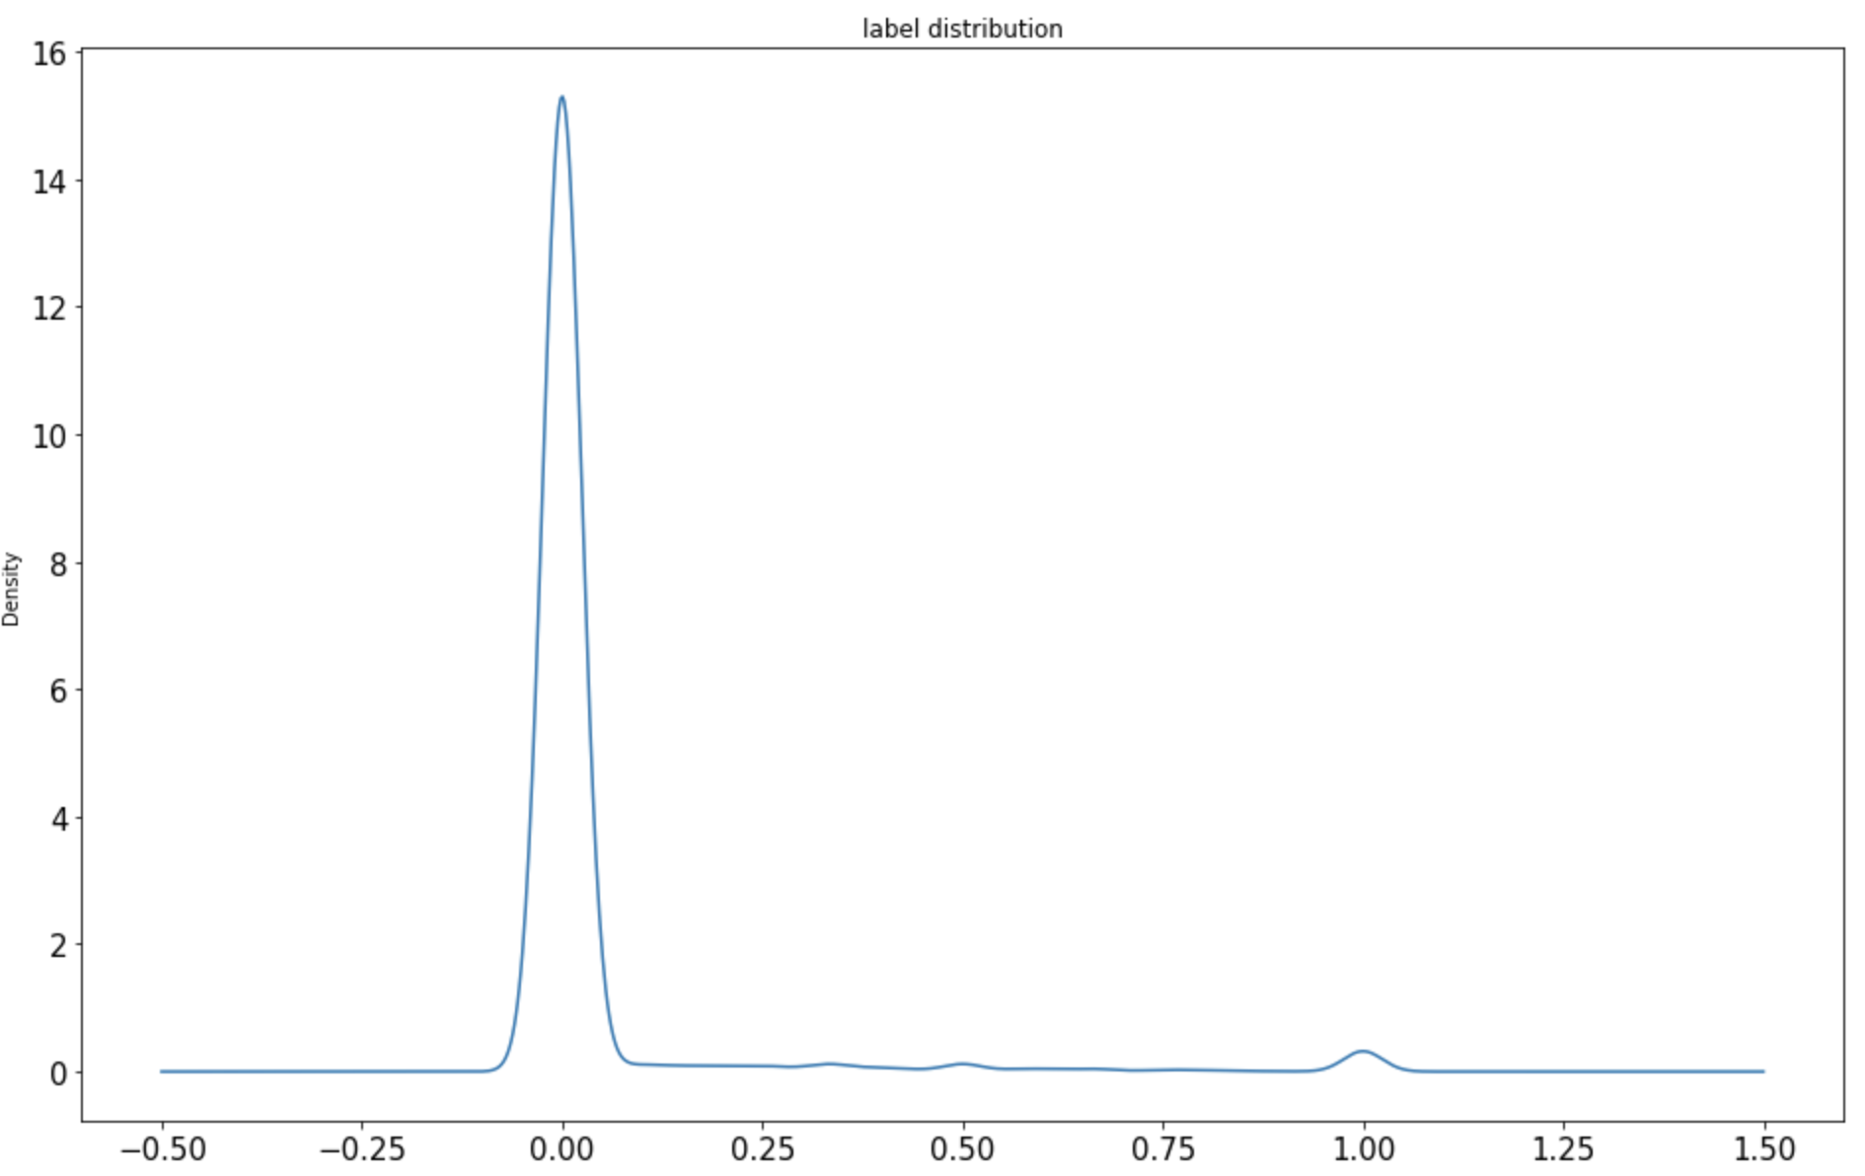
The Approach-Keywords Prediction
What label distribution looks like?
Notes:
Let’s look at Label distribution.

Slide 19
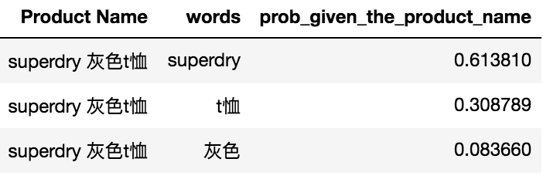
The Approach-Keywords Prediction
XGboost Regressor x2 (Simple Ensemble: voting)
Weighted Average

Slide 20
The Approach
A diagram of my keywords recommendation system flow
4
Notes:
Finally, it’s the last step F1-score maximization algorithm
I’m going to tell about why using this algorithm and how I applied the algorithm into our task in hand.

Slide 21
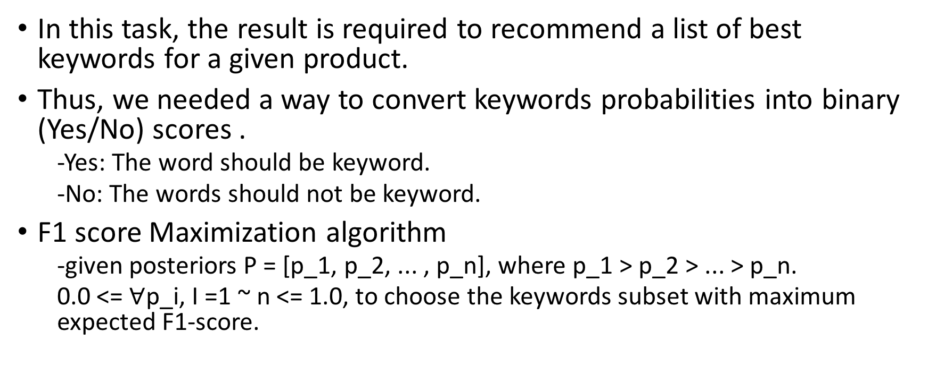
The Approach-F1 score Maximization
In this task, the result is required to recommend a list of best keywords for a given product.
Thus, we needed a way to convert keywords probabilities into binary (Yes/No) scores .
-Yes: The word should be keyword.
-No: The words should not be keyword.
F1 score Maximization algorithm
-given posteriors P = [p_1, p_2, ... , p_n], where p_1 > p_2 > ... > p_n.
0.0 <= $∀\text{p}\text{_}\text{i}\text{,}$I =1 ~ n <= 1.0, to choose the keywords subset with maximum expected F1-score.

Slide 22
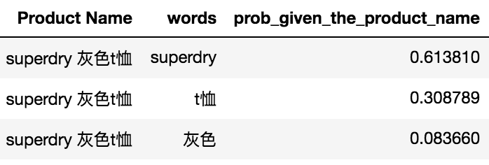
The Approach-F1 score Maximization(Case Explanation)
Let’s saying we have a a product name “superdry 灰色t恤”, and ..
Notes:
Let’s saying we have a a product name “superdry 灰色t恤”, and we got the probability that each word will be the bestkeyword , which is predicted by our system, the word superdry has 0.613, t恤 has 0.308, and 灰色only has 0.08.
Click:

Slide 23
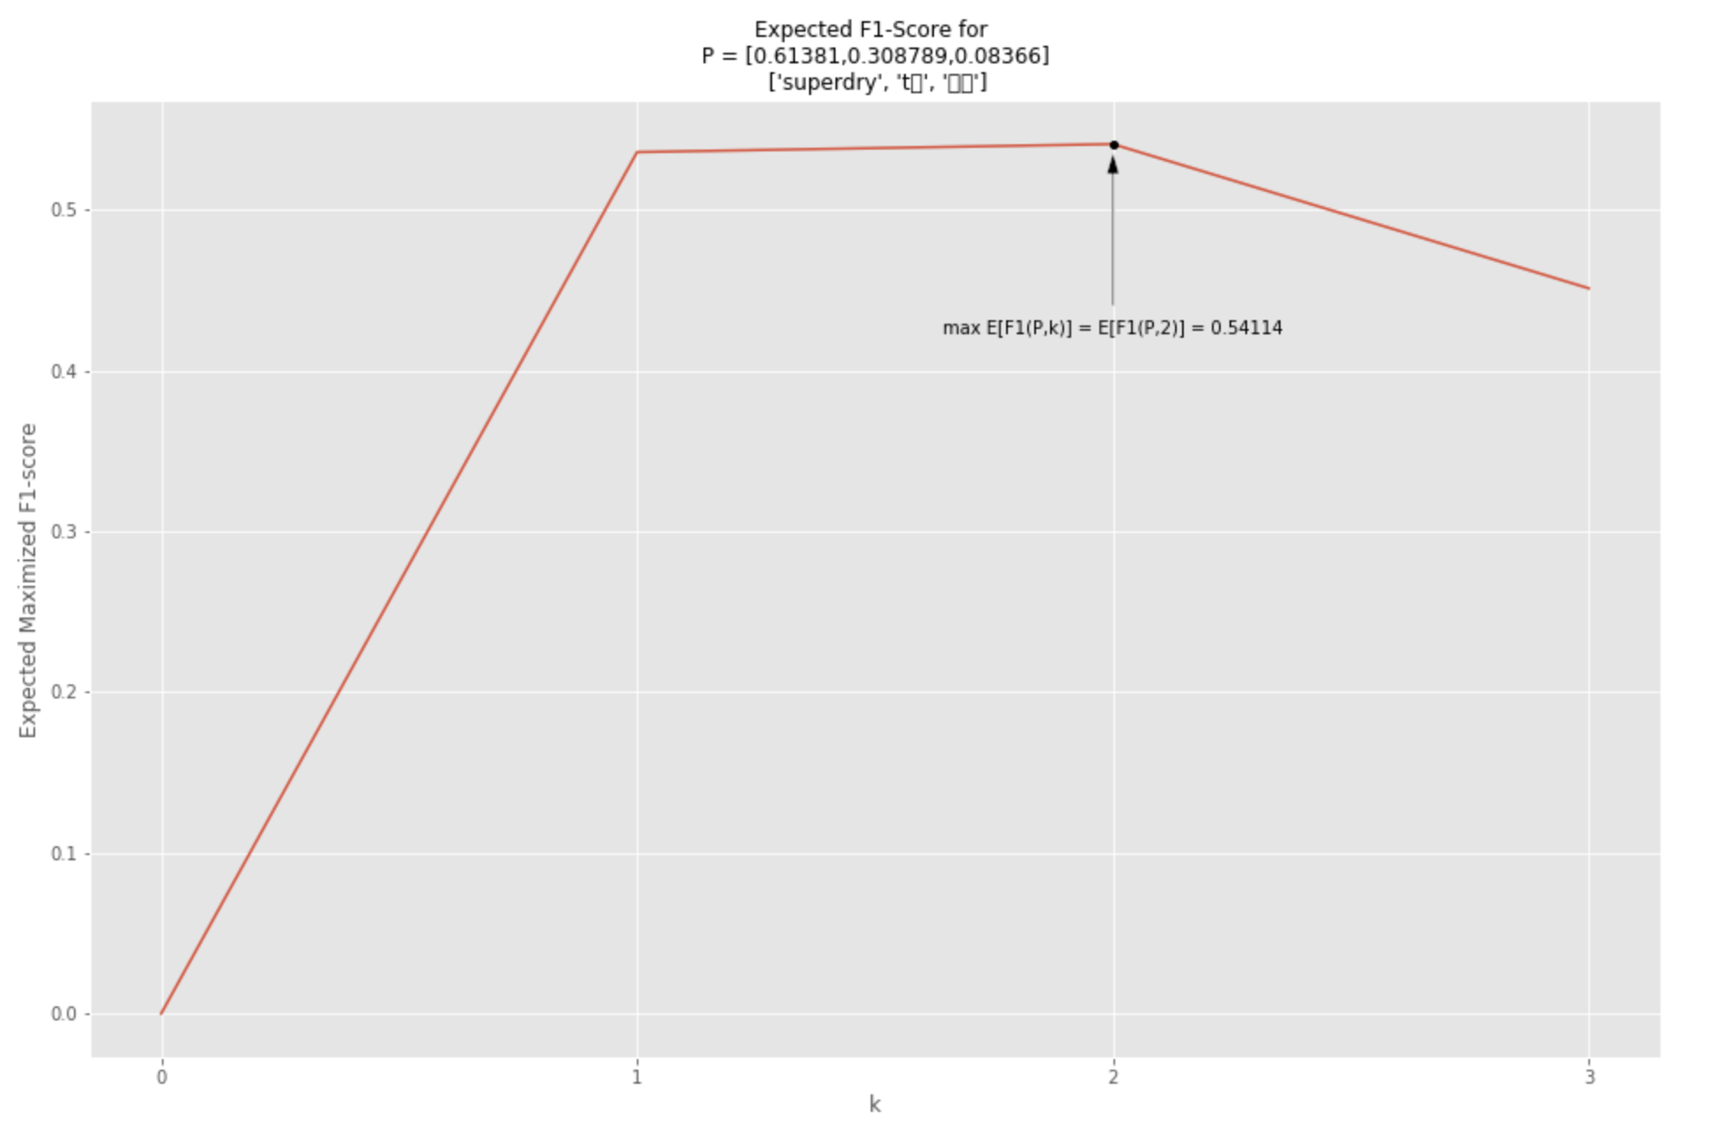
The Approach-F1 score Maximization(Case Explanation)
[superdry, t恤]
[superdry]
[superdry, t恤, 灰色]

Slide 24
Feature Engineering
I created four types of features.
Category features - What is the product’s category?
Product Name x word features - What’s the relationship between a specific product name and words?
Hot Search features - How well the words are searched by users?
Semantic features - What are the semantics of the extracted words?

Slide 25
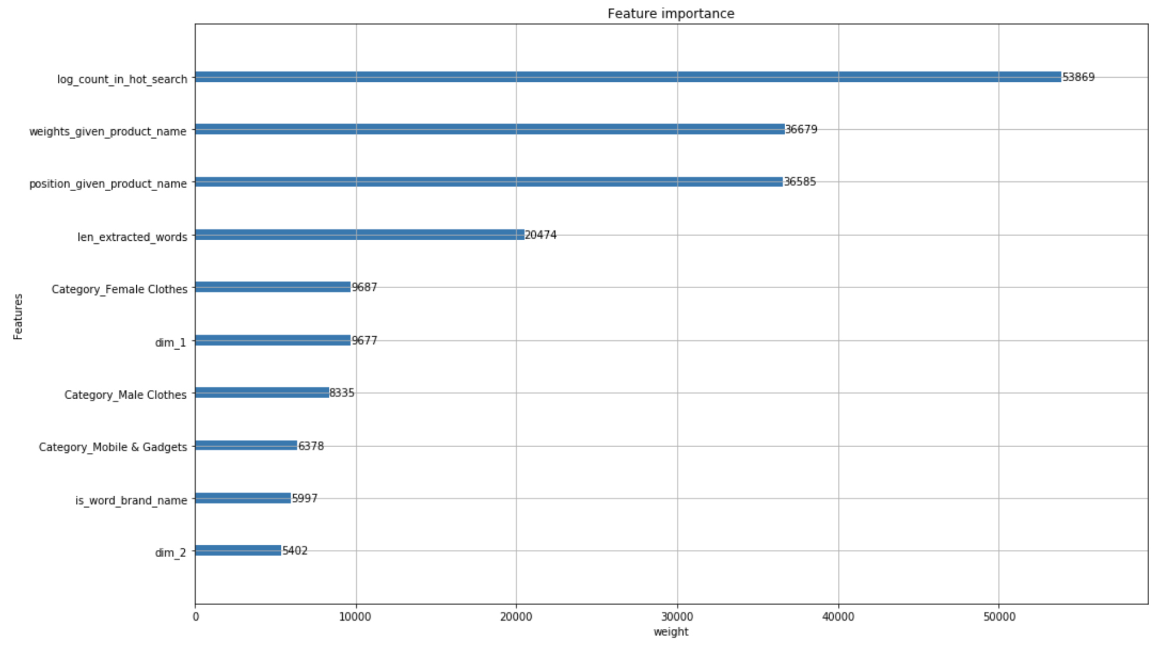
Feature Importance
Which features are the most significant?
For example, a product name, “蘋果手機大特賣”,
then the position of extracted words of “蘋果” is 1,
the position of extracted words of “手機” is 2,
and so on.
For example, the length of extracted words given “蘋果手機大特賣” is 3 since it has separately 3 extracted words: “頻果”, “手機”, and “大特賣”.

Slide 26
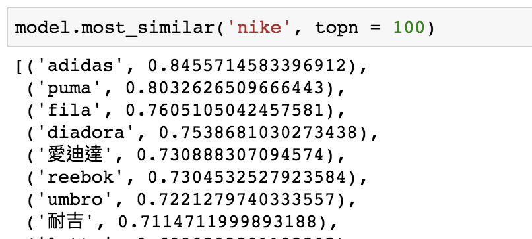
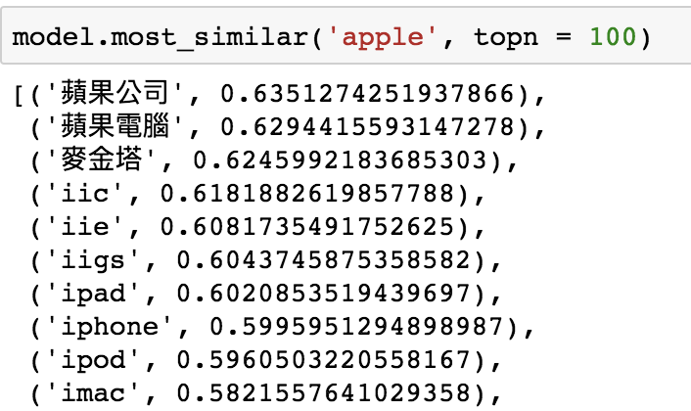
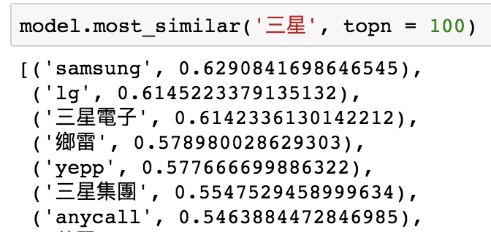
Insights
Why consider semantic features?
Many Synonyms
三星 and samsung
apple and I phone
nike and 耐吉
Inefficiently to write a lot of if-else statements ☹

Slide 27
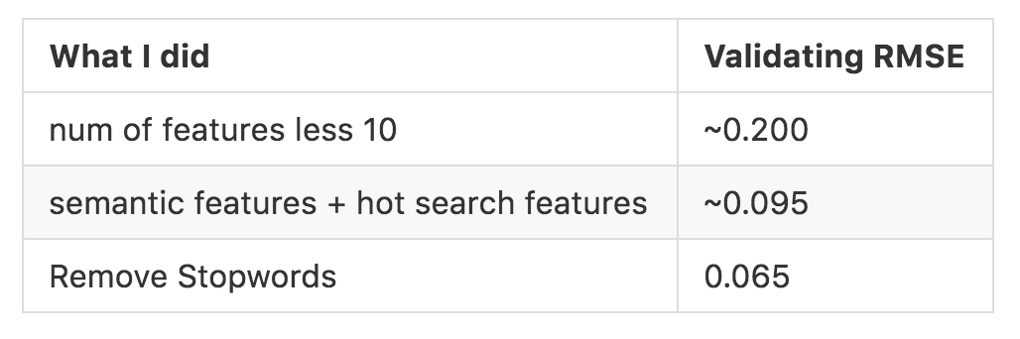
Experiments

Slide 28
Conclusion and Future work
I designed an algorithm to implement a keyword recommendation system, integrating:
Jieba
Gensim
Xgboost
f1 score maximization: to determine a list of best keywords.
Validating RMSE: 0.065, demonstrating that predicting ratio that users used a certain word to look for products is achievable.
A practical strategy to convert probabilities into list of best keywords.

Slide 29
Q&A
Thank you for your listening.

Slide 30
Reference
How to obtain a semantic space using gensim, trained on wiki corpus: https://radimrehurek.com/gensim/models/word2vec.html
F1-score maximization algorithm: https://www.kaggle.com/mmueller/f1-score-expectation-maximization-in-o-n

